Slide 1
Interpolation Search & Jump Search

Slide 2
Interpolation Search (Tìm kiếm nội suy)
Improvement over Binary Search for instances, where the values in a sorted array are uniformly distributed
Binary Search always goes to the middle element to check. Interpolation search may go to different locations according to the value of the key being searched. For example, if the value of the key is closer to the last element, interpolation search is likely to start search toward the end side

Slide 3
Interpolation Search (Tìm kiếm nội suy)
Step1: In a loop, calculate the value of “pos” using the probe position formula.
Step2: If it is a match, return the index of the item, and exit.
Step3: If the item is less than arr[pos], calculate the probe position of the left sub-array. Otherwise, calculate the same in the right sub-array.
Step4: Repeat until a match is found or the sub-array reduces to zero.

Slide 4
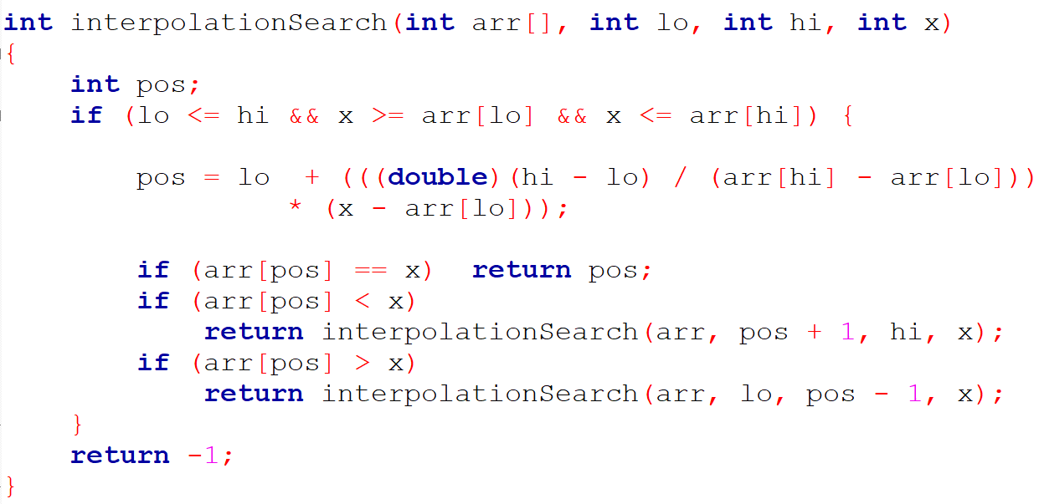

Slide 5
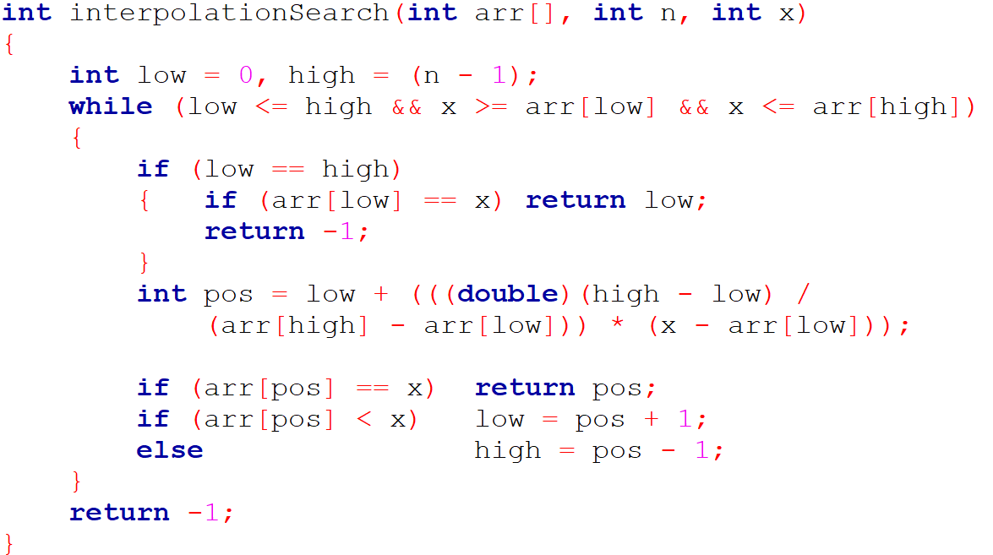

Slide 6
Jump Search (Tìm kiếm nhảy)
The basic idea is to check fewer elements (than linear search) by jumping ahead by fixed steps or skipping some elements in place of searching all elements
For example, suppose we have an array arr[] of size n and a block (to be jumped) of size m. Then we search in the indexes arr[0], arr[m], arr[2m]…..arr[km] and so on. Once we find the interval (arr[km] < x < arr[(k+1)m]), we perform a linear search operation from the index km to find the element x.

Slide 7
Jump Search (Tìm kiếm nhảy)
Let’s consider the following array: (0, 1, 1, 2, 3, 5, 8, 13, 21, 34, 55, 89, 144, 233, 377, 610). The length of the array is 16. The Jump search will find the value of 55 with the following steps assuming that the block size to be jumped is 4.
STEP 1: Jump from index 0 to index 4; STEP 2: Jump from index 4 to index 8; STEP 3: Jump from index 8 to index 12; STEP 4: Since the element at index 12 is greater than 55, we will jump back a step to come to index 8. STEP 5: Perform a linear search from index 8 to get the element 55.
m = sqrt(n)

Slide 8
Jump Search (Tìm kiếm nhảy)
The steps are determined by the sqrt of the length of the array.
Start at the first element of the array and jump m steps until the value at that position is greater than the target value.
Once a value greater than the target is found, perform a linear search starting from the previous step until the target is found or it is clear that the target is not in the array.
If the target is found, return its index. If not, return -1 to indicate that the target was not found in the array.

Slide 9
